Slide 1
Title of Topic: Data Models – Introduction, Benefits, and Phases, ER Diagrams – Symbols, Components, Relationships, Weak entities, Attributes, Cardinality Course Code: 23IT201 Course Title: Database Management Systems Academic Year: 2024 - 2025 (Even Sem)
23IT201- DATABASE MANAGEMENT SYSTEMS
Module 1

Slide 2
1. Introduction to DBMS, Characteristics of DBMS, DBMS vs File Systems, need for DBMS. 2. Three Level DBMS Architecture. 3. Data Models, Introduction, Benefits, and Phases. ER Diagrams – Symbols, Components, Relationships, Weak entities, Attributes, Cardinality. 4.Relational Algebra, Domain Relational Calculus, Tuple Relational Calculus, 5. Keys - primary Key, Foreign Key.
23IT201- DATABASE MANAGEMENT SYSTEMS
Module 1 – INTRODUCTION
Module 1
2

Slide 3
23IT201- DATABASE MANAGEMENT SYSTEMS
Data Models – Introduction, Benefits, and Phases, ER Diagrams – Symbols, Components, Relationships, Weak entities, Attributes, Cardinality
Topics to be Covered
Hierarchical Data Model
Network Data Model
Relational Data Model
ER Model to Relational Model Mapping
Data Models
Types of Data Models
Physical Data Models
Object Based Data Models
Entity Relationship (ER) Data Model
Object Oriented (OO) Data Model
Record Based Data Models
Module 1

Slide 4

23IT201- DATABASE MANAGEMENT SYSTEMS
Data Models
Define how the logical structure of a database is modelled
Define how data is connected to each other
Define how they are processed and stored in system
Planning the structure of database is called data models
Helps to put the real world requirements into a design
Collection of conceptual tools for describing data, data relationships, data semantics and consistency constraints
Helps to highlight any drawbacks of the plan and correct it at the design stage itself
Data Models:
Module 1

Slide 5
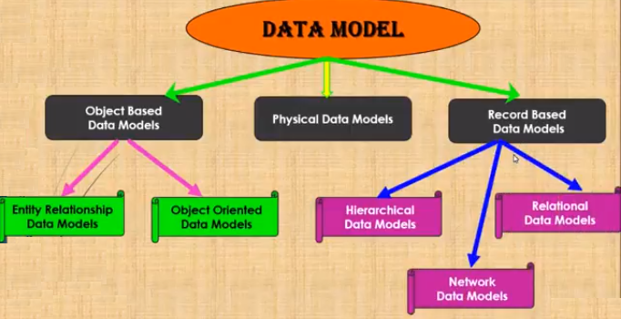

23IT201- DATABASE MANAGEMENT SYSTEMS
Types of Data Models
Tools to draw Data Models (ER Diagram):
Module 1 – DataBase System Architecture
Module 1
5

Slide 6
23IT201- DATABASE MANAGEMENT SYSTEMS
Physical Data Models
Describe how data are stored, scattered and ordered in computer memory
Describe how data would be retrieved from memory
Represents the data at data layer or internal layer
Represents each table, their columns and specifications, constraints like primary key, foreign key, etc…
Basically represents how each tables are built and related to each other in DB
Has tables and its specifications - Table names and their columns
Has foreign keys - Used to represent the relationship between the tables
Have de-normalized structure based on the user requirement
Dependent on the RDBMS
Physical Data Models:
Module 1 – DataBase System Architecture
Module 1
6

Slide 7
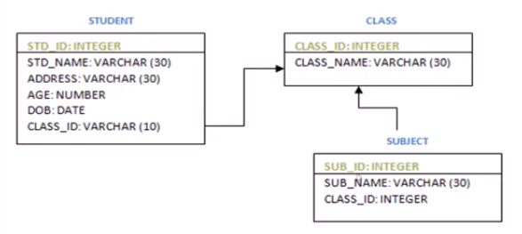
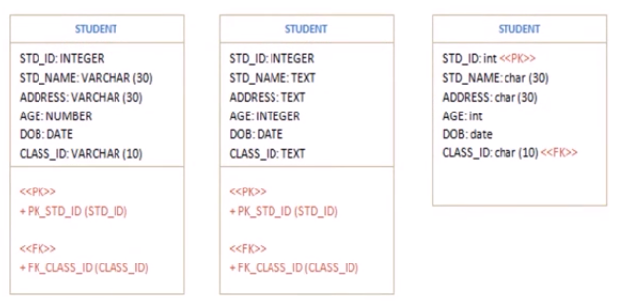
23IT201- DATABASE MANAGEMENT SYSTEMS
Physical Data Models
Representation of physical data model diagram may be different, though it contains same information
Depends on the user/designer how the diagram and the RDBMS servers are specified
Module 1 – DataBase System Architecture
Module 1
7

Slide 8
23IT201- DATABASE MANAGEMENT SYSTEMS
Object Based Data Models
Designed using the entities in the real world, attributes of each entity and their relationship
Picks up each thing/object in the real world which is involved in the requirement
Types
Entity Relationship Data Model
Object Oriented Data Model
Object Based Data Models:
Module 1 – DataBase System Architecture
Module 1
8

Slide 9
23IT201- DATABASE MANAGEMENT SYSTEMS
Entity Relationship (ER) Data Model
Represents the entities, attributes and their relationship in the form of picture to make the developer understand the system better
Graphical representation of real world objects with their attributes and relationship
Makes the system easily understandable
Considered as a top down approach of designing a requirement
Developed to facilitate database design by allowing specification of an enterprise schema that represents the overall logical structure of a database
Module 1 – DataBase System Architecture
Module 1
9

Slide 10
23IT201- DATABASE MANAGEMENT SYSTEMS
Entity Relationship (ER) Data Model
Very useful in mapping the meanings and interactions of real-world enterprises onto a conceptual schema and because of this many database-design tools draw on concepts from the ER model
Employs three basic concepts such as entity sets, relationship sets, and attributes
Has an associated diagrammatic representation, the ER diagram, which can express the overall logical structure of a database graphically
Entity Sets
An object that exists and is distinguishable from other objects
Entity is a real or abstract object (depends on requirement)
Maybe Person, Place or Building – identifier
Part of an enterprise that is of interest. E.g., Person, Company, Event, Plant
Module 1 – DataBase System Architecture
Module 1
10

Slide 11
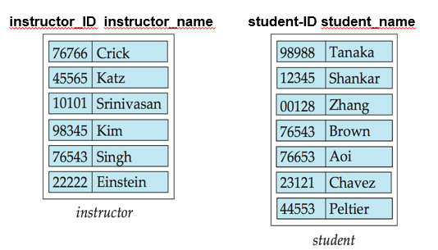
23IT201- DATABASE MANAGEMENT SYSTEMS
Entity Relationship (ER) Data Model
Entity Sets
Set of entities of the same type that share the same properties. E.g., Set of all Persons, Companies, Trees, Holidays
Student entity set might represent the set of all students in the university
An entity is represented by a set of attributes; i.e., descriptive properties possessed by all members of an entity set
E.g., instructor = (ID, name, street, city, salary)
course= (course_id, title, credits)
A subset of the attributes form a primary key of the entity set; i.e., uniquely identifying each member of the set
Module 1 – DataBase System Architecture
Module 1
11

Slide 12
23IT201- DATABASE MANAGEMENT SYSTEMS
Entity Relationship (ER) Data Model
Relationship Sets
A relationship is an association among several entities
E.g., A relationship advisor can be defined that associates instructor Katz with student Shankar. This relationship specifies that Katz is an advisor to student Shankar
A relationship set is a set of relationships of the same type. Formally, it is a mathematical relation on n ≥ 2 (possibly non distinct) entity sets. If E1, E2,..., En are entity sets, then a relationship set R is a subset of
{(e₁, e₂, … e_{n}) | e₁ ∈ E₁, e₂ ∈ E₂, …, e_{n} ∈ E_{n}}; where (e₁, e₂, …, e_{n}) is a
relationship
An attribute can also be associated with a relationship set
Module 1 – DataBase System Architecture
Module 1
12

Slide 13
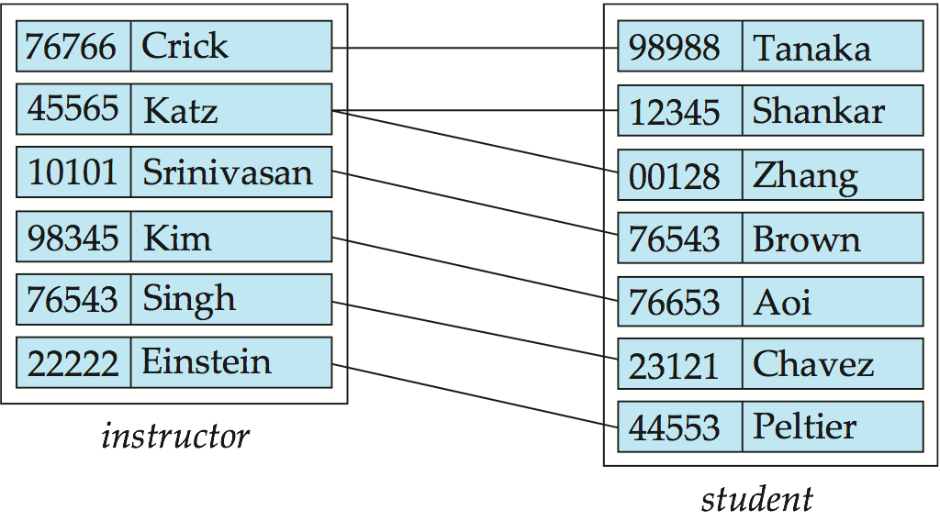
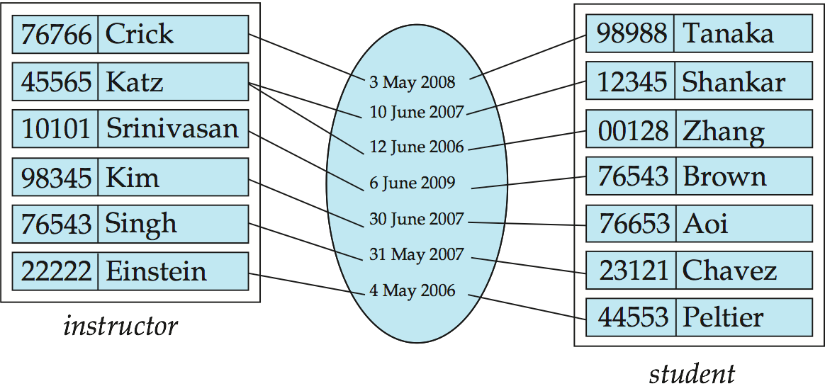
23IT201- DATABASE MANAGEMENT SYSTEMS
Entity Relationship (ER) Data Model
Relationship Sets
For instance, the advisor relationship set between entity sets instructor and student may have the attribute date which tracks when the student started being associated with the advisor
Module 1 – DataBase System Architecture
Module 1
13

Slide 14
23IT201- DATABASE MANAGEMENT SYSTEMS
Entity Relationship (ER) Data Model
Relationship Types
Relationships are associations or connections that exist between entities and may be looked at as mappings between two or more entity sets
Although we allow relationships among any number of entity sets, the most common cases are binary relationships between two entity sets
Mapping two or more entity sets. E.g., Player and Match
Three types of relationship
Binary Relationship
Recursive Relationship
Ternary Relationship
Module 1 – DataBase System Architecture
Module 1
14

Slide 15
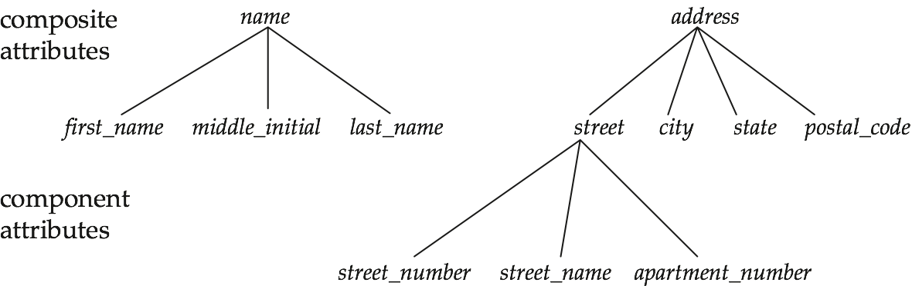
23IT201- DATABASE MANAGEMENT SYSTEMS
Entity Relationship (ER) Data Model
Attributes
For each attribute, there is a set of permitted values, called the domain, or value set, of that attribute. E.g., Domain of attribute semester might be strings from the set {Fall, Winter, Spring, Summer}
Attribute types:
Simple or composite attributes.
Single-valued or multivalued attributes
Stored or Derived
Required or Optional
Simple: Attributes not sub divided. E.g., Country, Place of Birth
Composite: Attributes that are sub divided. E.g., Dob, Name, Address
Single Valued: Many attributes have a single value. E.g., Regno
Module 1 – DataBase System Architecture
Module 1
15

Slide 16
23IT201- DATABASE MANAGEMENT SYSTEMS
Entity Relationship (ER) Data Model
Attribute types:
Simple or composite attributes.
Single-valued or multivalued attributes
Example: multivalued attribute: phone_numbers
Derived attributes
Can be computed from other attributes
Example: age, given date_of_birth
- Stored or Derived
- Required or Optional
Module 1 – DataBase System Architecture
Module 1
16

Slide 17
23IT201- DATABASE MANAGEMENT SYSTEMS
Entity Relationship (ER) Data Model
Attributes
Simple or composite
Multi-valued: Some attributes have multiple values. E.g., Umpire - TV, Refree, Reserve Umpire
Single Valued : regno
Stored : Attribute values that are related. E.g., Players Career, Batting Average
Derived: Value for this type of attribute can be derived from the values of other related attributes or entities. E.g., Age derived from DOB
Required: Necessary. E.g., match ID
Optional: It may or may not be necessary. E.g., An attribute takes a null value when an entity does not have a value for it
Module 1 – DataBase System Architecture
Module 1
16

Slide 18
Composite Attributes
Simple : attributes not sub divided Eg: country, place of birth
Composite : attributes that are sub divided Eg: dob,Name

Slide 19
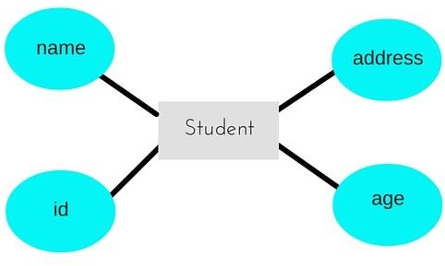
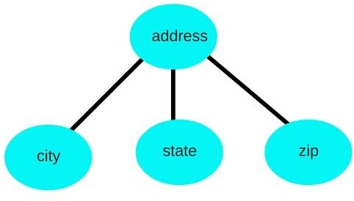
Composite Attributes

Slide 20
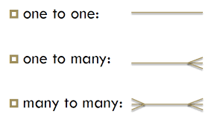
23IT201- DATABASE MANAGEMENT SYSTEMS
Entity Relationship (ER) Data Model
Mapping Cardinality Constraints
Mapping Cardinality or Cardinality Ratios express the number of entities to which another entity can be associated via a relationship set
Maximum number of relationship instances that an entity can participate in. E.g., Employee and Office
Most useful in describing binary relationship sets
For a binary relationship set the mapping cardinality must be one of the following types:
Module 1 – DataBase System Architecture
Module 1
17

Slide 21
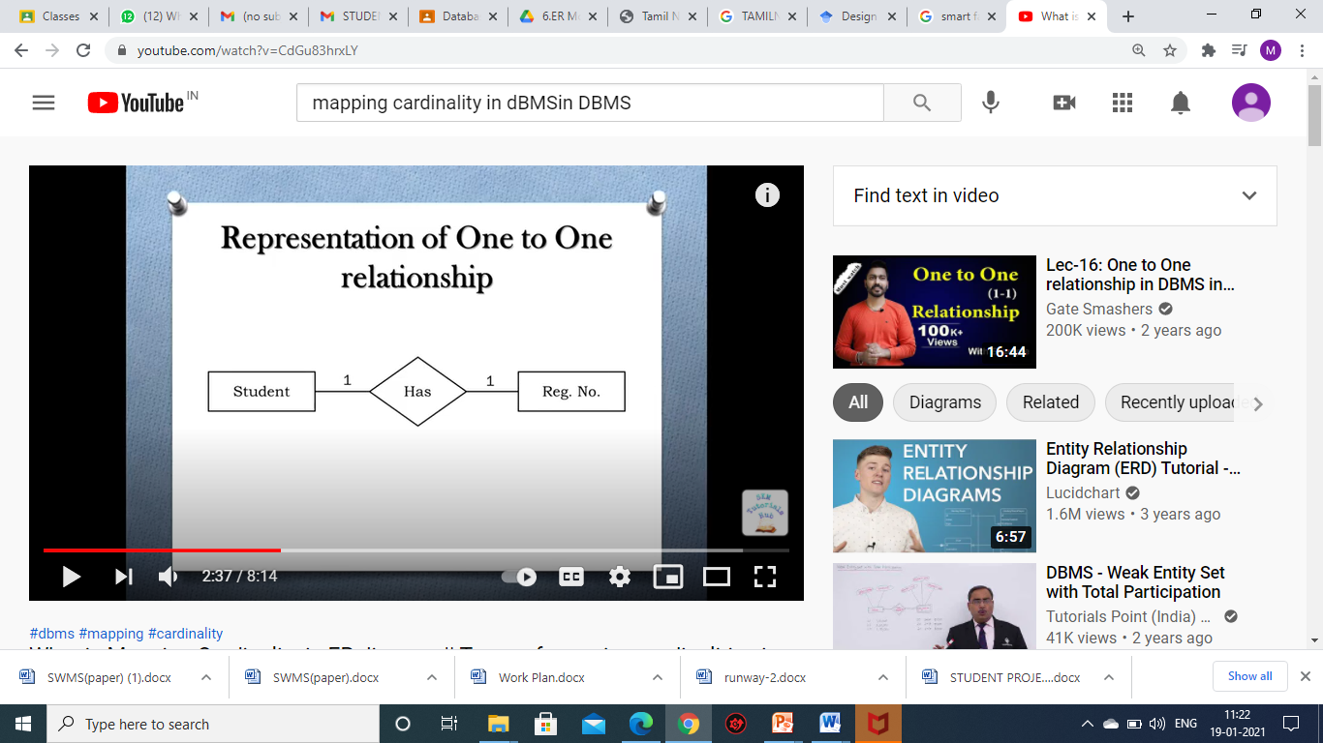
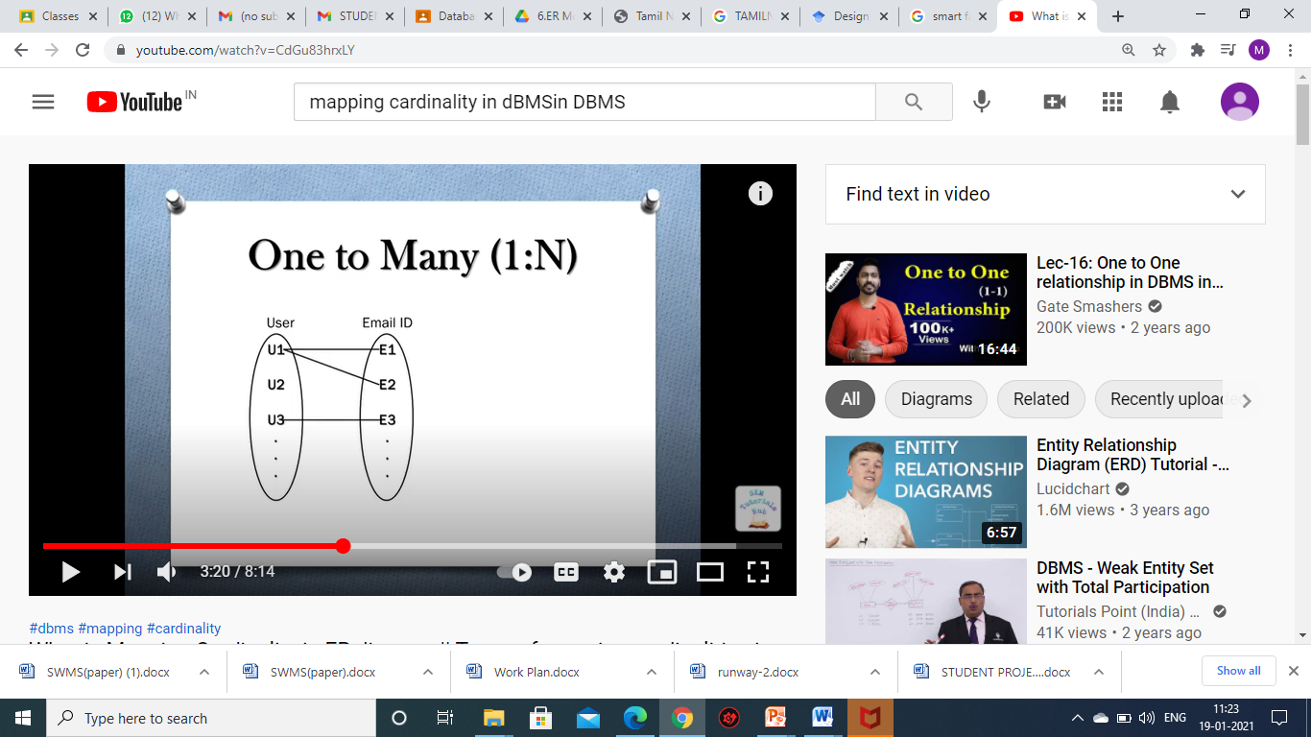
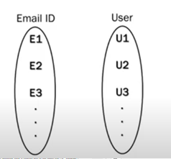
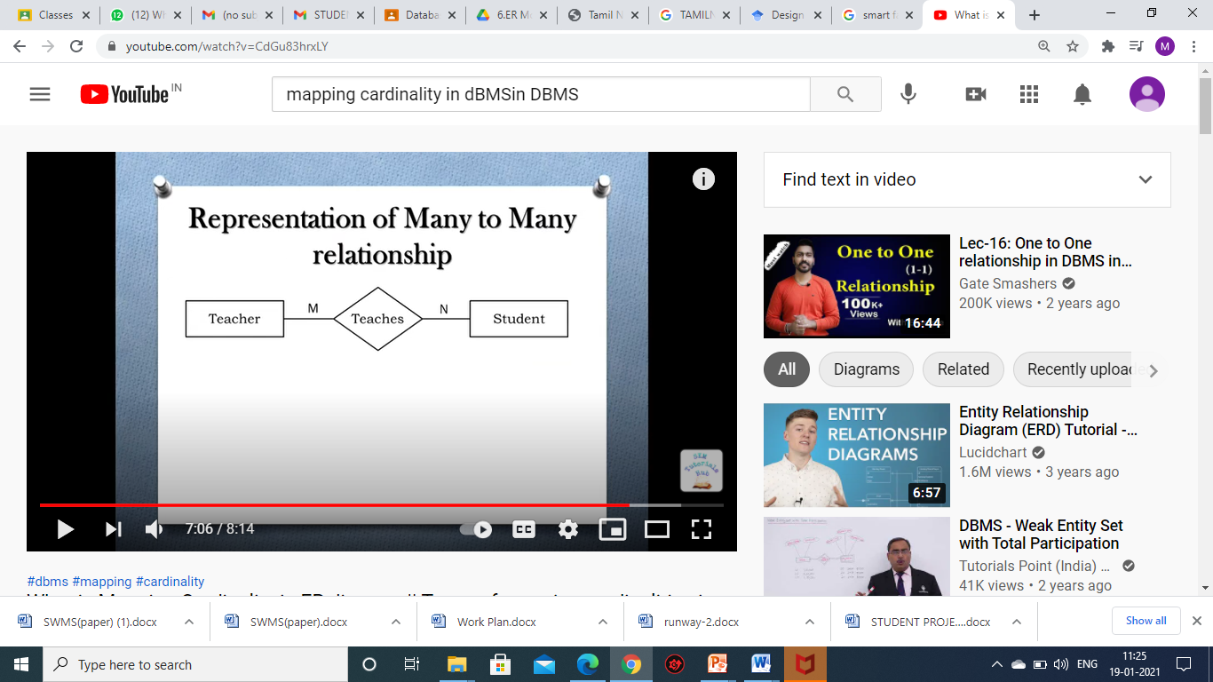
23IT201- DATABASE MANAGEMENT SYSTEMS
Entity Relationship (ER) Data Model
Mapping Cardinality Constraints
One to One
Many to One
One to Many
Many to Many
Module 1 – DataBase System Architecture
Module 1
18

Slide 22
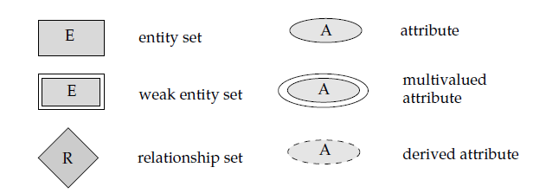
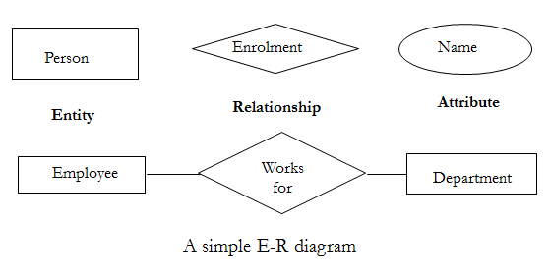
23IT201- DATABASE MANAGEMENT SYSTEMS
Entity Relationship (ER) Data Model
Start by identifying those entity sets that should be included
Choose the appropriate attributes for entity sets. E.g., instructor entity set, we will include the attributes ID, name, dept name, and salary
The relationship sets among the various entities are formed
These relationship sets may result in a situation where attributes in the various entity sets are redundant and need to be removed from the original entity sets
Module 1 – DataBase System Architecture
Module 1
19

Slide 23
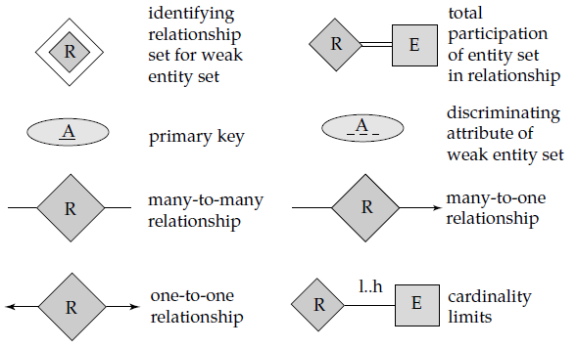
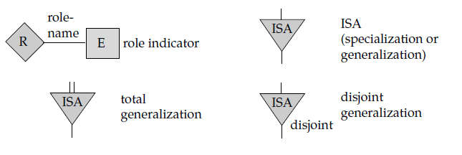
23IT201- DATABASE MANAGEMENT SYSTEMS
Entity Relationship (ER) Data Model
Module 1 – DataBase System Architecture
Module 1
20

Slide 24
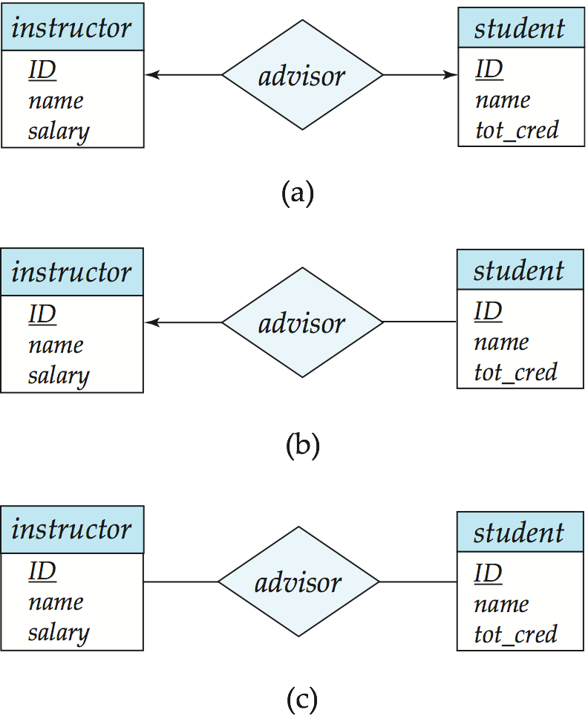
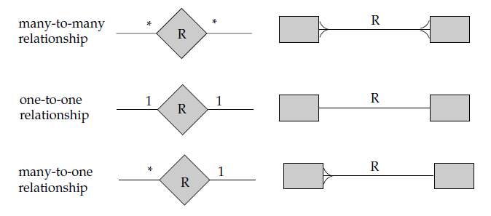

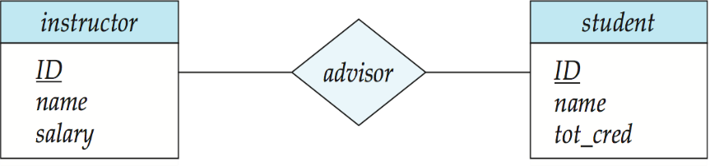
23IT201- DATABASE MANAGEMENT SYSTEMS
Entity Relationship (ER) Data Model
One-to-Many Relationship
Many-to-One Relationship
Many-to-Many Relationship
Module 1 – DataBase System Architecture
Module 1
21

Slide 25
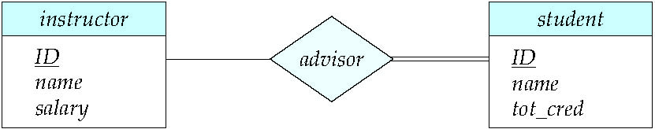
23IT201- DATABASE MANAGEMENT SYSTEMS
Entity Relationship (ER) Data Model
Total Participation (indicated by double line)
Every entity in the entity set participates in at least one relationship in the relationship set.
E.g., Participation of student in advisor relation is total - Every student must have an associated instructor
Partial Participation (indicated by single line)
Some entities may not participate in any relationship in the relationship set
E.g., Participation of instructor in advisor is partial
Module 1 – DataBase System Architecture
Module 1
22

Slide 26
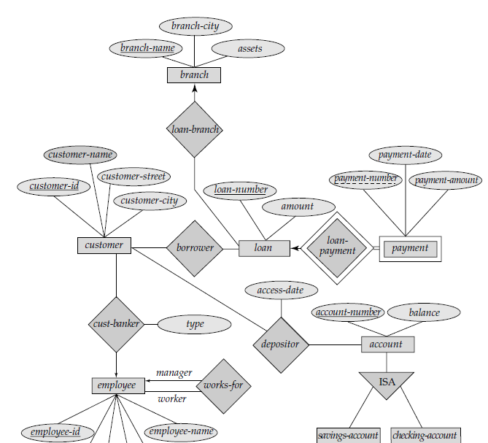
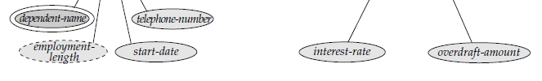
23IT201- DATABASE MANAGEMENT SYSTEMS
Entity Relationship (ER) Data Model
Module 1 – DataBase System Architecture
Module 1
23

Slide 27
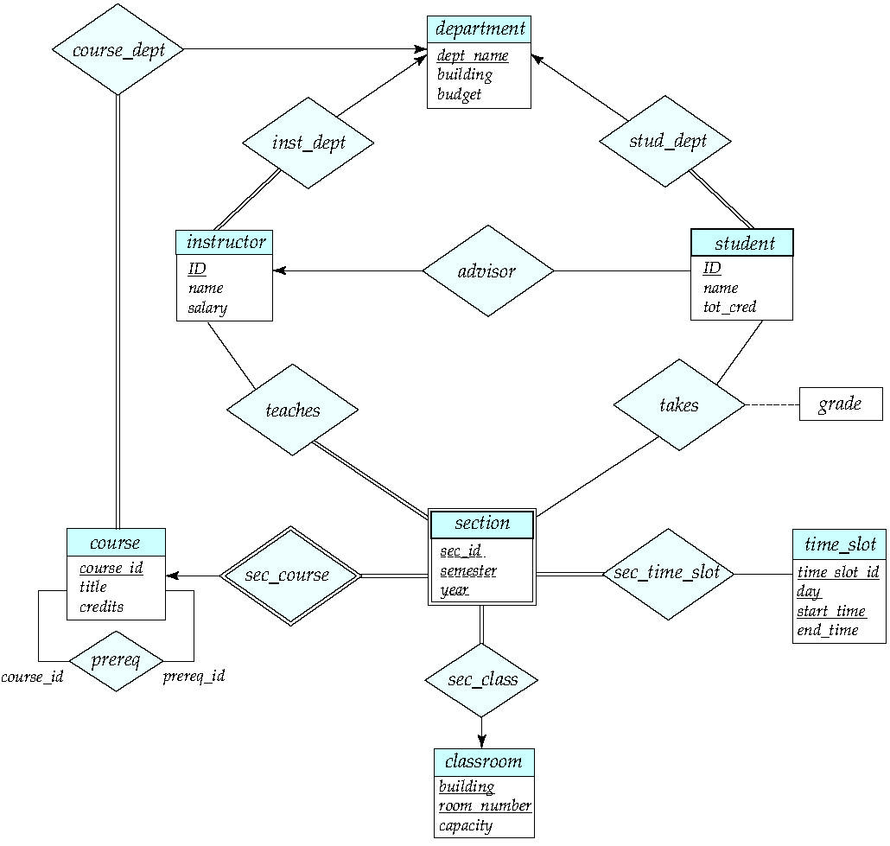
23IT201- DATABASE MANAGEMENT SYSTEMS
Entity Relationship (ER) Data Model
Module 1 – DataBase System Architecture
Module 1
24

Slide 28
23IT201- DATABASE MANAGEMENT SYSTEMS
Entity Relationship (ER) Data Model
Redundant Attributes
Each instructor has an associated department using a relationship set inst_dept and attribute dept_name appears in both entity sets as shown:
instructor, with attributes: ID, name, dept_name, salary
department, with attributes: dept_name, building, budget
As it is the primary key for the entity set department, it replicates information present in the relationship and is therefore redundant in the entity set instructor and needs to be removed
When converting back to tables, in some cases the attribute gets reintroduced
Module 1 – DataBase System Architecture
Module 1
25

Slide 29
23IT201- DATABASE MANAGEMENT SYSTEMS
Entity Relationship (ER) Data Model
Weak Entity Sets
Entity set that does not have sufficient attributes to form a primary key
Entity set that has a primary key is termed a strong entity set
Consider a section entity, which is uniquely identified by a course_id, semester, year, and sec_id
Clearly, section entities are related to course entities. Suppose a relationship set sec_course is created between entity sets section and course
Here, sec_course is redundant, since section already has an attribute course_id, which identifies the course with which the section is related
One option to deal with this redundancy is to get rid of the relationship sec_course; however, by doing so the relationship between section and course becomes implicit in an attribute, which is not desirable
Module 1 – DataBase System Architecture
Module 1
26

Slide 30
23IT201- DATABASE MANAGEMENT SYSTEMS
Entity Relationship (ER) Data Model
Weak Entity Sets
An alternative way to deal with this redundancy is to not store the attribute course_id in the section entity and to only store the remaining attributes section_id, year, and semester
The entity set section does not have enough attributes to identify a particular section entity uniquely; although each section entity is distinct, sections for different courses may share the same section_id, year, and semester
To deal with this problem, the relationship sec_course is treated as a special relationship that provides extra information, in this case, the course_id, required to identify section entities uniquely
The notion of weak entity set formalizes the above intuition and a weak entity set is depicted via a double rectangle
Module 1 – DataBase System Architecture
Module 1
27

Slide 31
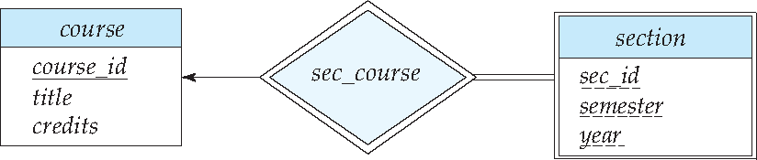
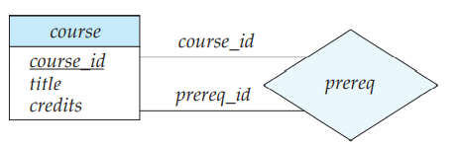
23IT201- DATABASE MANAGEMENT SYSTEMS
Entity Relationship (ER) Data Model
Weak Entity Sets
The discriminator of a weak entity set is shown with a dashed line
The relationship set connecting the weak entity set to the identifying strong entity set is depicted by a double diamond
Key will be - course_id, semester, year, and sec_id
Unary Relationship
The role indicators course_ id and prereq_id between the course entity set and the prereq relationship set are indicated as shown
Module 1 – DataBase System Architecture
Module 1
28

Slide 32
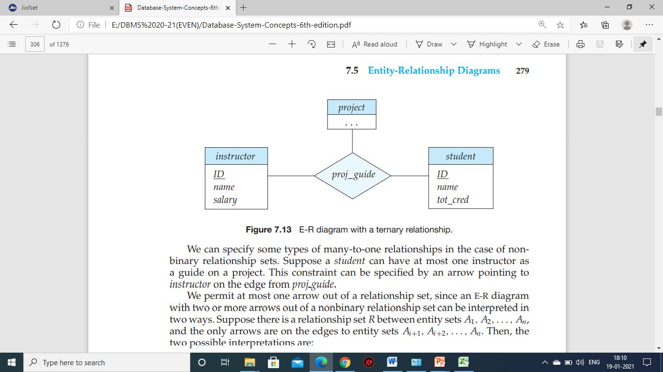
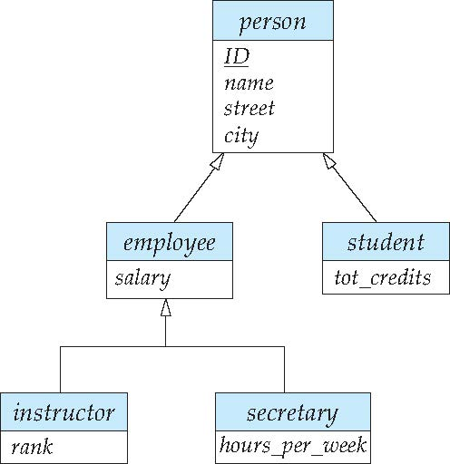
23IT201- DATABASE MANAGEMENT SYSTEMS
Entity Relationship (ER) Data Model
Nonbinary Relationship Sets (Ternary relationship)
Consists of the three entity sets instructor, student, and project, related through the relationship set proj_guide
Extended E-R Features: Specialization
An entity set may include subgroupings of entities that are distinct in some way from other entities in the set
The process of designating subgroupings within an entity set is called specialization. E.g., person may be further classified as one of the following:
employee
student
Module 1 – DataBase System Architecture
Module 1
29

Slide 33
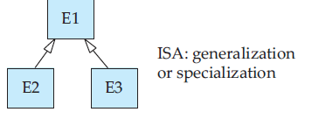
23IT201- DATABASE MANAGEMENT SYSTEMS
Entity Relationship (ER) Data Model
Extended E-R Features: Generalization
A bottom-up design process – combine a number of entity sets that share the same features into a higher-level entity set
The commonality can be expressed by generalization, which is a containment relationship that exists between a higher-level entity set and one or more lower-level entity sets
Specialization and generalization are simple inversions of each other; they are represented in an E-R diagram in the same way and they are used interchangeably
Module 1 – DataBase System Architecture
Module 1
30

Slide 34
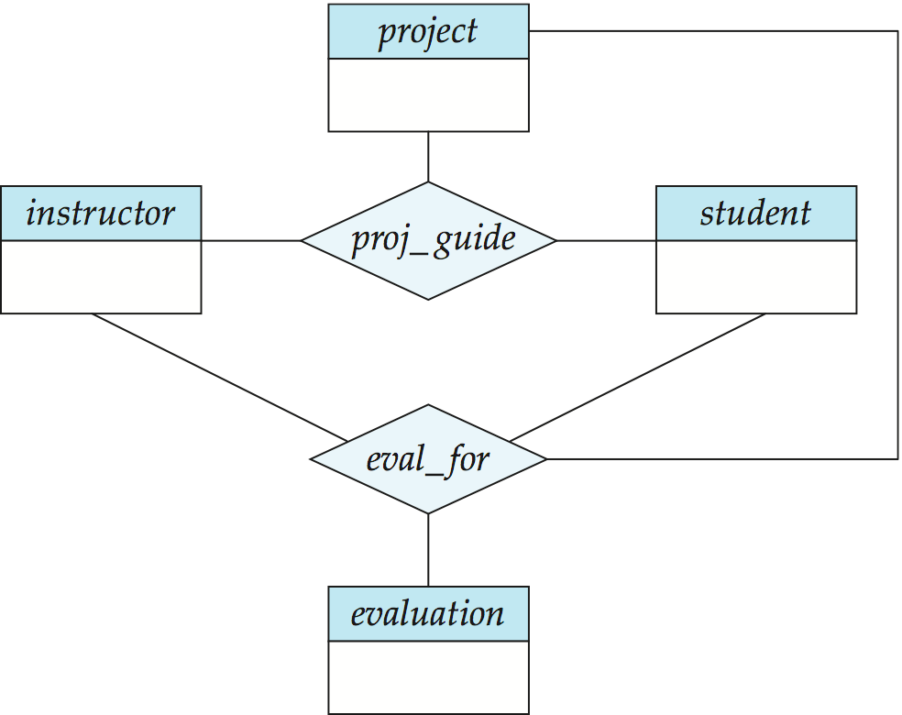
23IT201- DATABASE MANAGEMENT SYSTEMS
Entity Relationship (ER) Data Model
Aggregation
An abstraction through which relationships are treated as higher-level entities
To record evaluations of a student by a guide on a project
Eliminate this redundancy via aggregation without introducing redundancy, the following diagram represents
A student is guided by a particular instructor on a particular project
A student, instructor, project combination may have an associated evaluation
Module 1 – DataBase System Architecture
Module 1
31

Slide 35
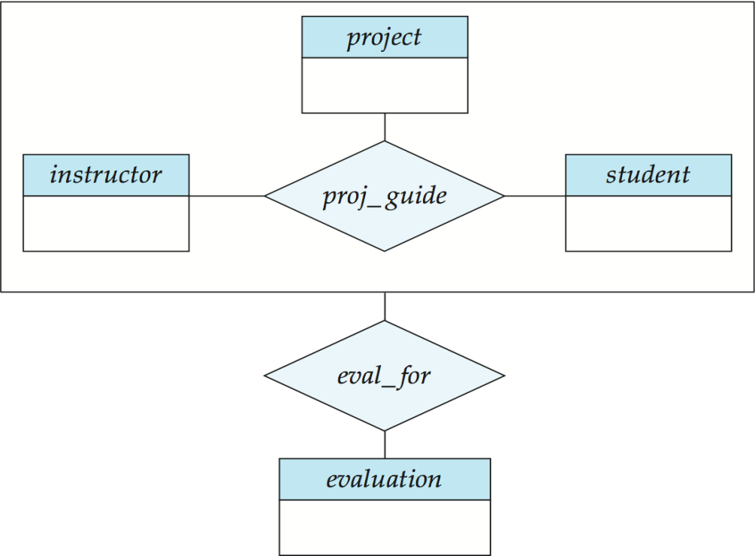
23IT201- DATABASE MANAGEMENT SYSTEMS
Entity Relationship (ER) Data Model
Aggregation
Relationship sets eval_for and proj_guide represent overlapping information
Every eval_for relationship corresponds to a proj_guide relationship
However, some proj_guide relationships may not correspond to any eval_for relationships
So it is not possible to discard the proj_guide relationship
This redundancy can be eliminated via aggregation
Treat relationship as an abstract entity
Allows relationships between relationships
Abstraction of relationship into new entity
Module 1 – DataBase System Architecture
Module 1
32

Slide 36
23IT201- DATABASE MANAGEMENT SYSTEMS
Entity Relationship (ER) Data Model
Advantages
Makes the requirement simple and easily understandable by representing simple diagrams
One can convert ER diagrams into record based data model easily
Easy to understand ER diagrams
Disadvantages
No standard notations are available for ER diagram
Flexibility in the notation depends upon the designer, how he draws it
Meant for high level designs which cannot be simplified for low level design like coding
Module 1 – DataBase System Architecture
Module 1
33

Slide 37
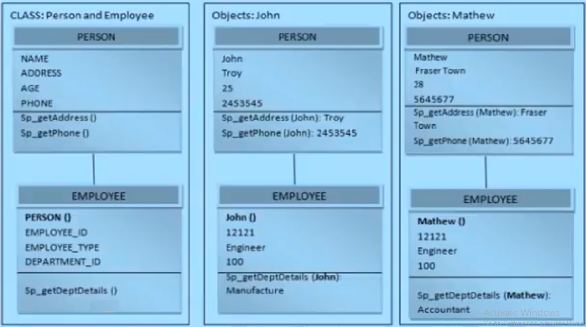
23IT201- DATABASE MANAGEMENT SYSTEMS
Object Oriented (OO) Data Model
Considers each object in the world as objects and isolates it from each other
Groups its related functionalities together and allows inheriting its functionality to other related sub-groups
Encapsulation
Binds the features in one class and hides it from other classes
Only visible to its objects and any inherited classes
Module 1 – DataBase System Architecture
Module 1
34

Slide 38
23IT201- DATABASE MANAGEMENT SYSTEMS
Object Oriented (OO) Data Model
Advantages
Inheritance property – Attributes and functionalities can be re-used
Reduces the cost of maintaining the same data multiple times
More flexible in the case of any changes
Codes are re-used and OO model is more understandable
Disadvantages
Not widely developed and complete to use it in the database systems. Hence not accepted by the users
Not a technology but a approach for solving the requirement. Hence, fails to put it in the DBMS
Module 1 – DataBase System Architecture
Module 1
35

Slide 39
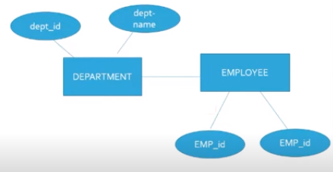
23IT201- DATABASE MANAGEMENT SYSTEMS
Record Based Data Models
Defines the actual relationship between the data in the entities
Based on application and user levels of data
Modeled considering the logical structure of the objects in the database
Types
Hierarchical Data Models
Network Data Models
Relational Data Models
Record Based Data Models:
Module 1 – DataBase System Architecture
Module 1
36

Slide 40
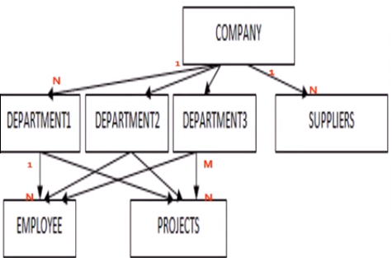
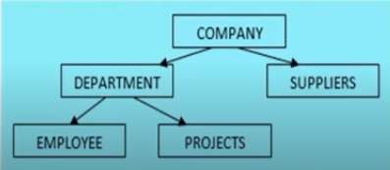
23IT201- DATABASE MANAGEMENT SYSTEMS
Hierarchical Data Model
Data is organized into a tree-like structure
Data is stored as records which are connected to one another through links
A record is a collection of fields, with each field containing only one value
Entities are represented in a hierarchical fashion
Here a parent entity and its child entity are identified
Again drill down is to be done to identify next level of child entity and soon
Module 1 – DataBase System Architecture
Module 1
37

Slide 41
23IT201- DATABASE MANAGEMENT SYSTEMS
Hierarchical Data Model
Advantages
Helps to address the issues of flat file data storage
In flat files, data will be scattered and there will not be any proper structuring of the data
Groups the related data into tables and defines the relationship between the tables, which is not addressed in flat files
Disadvantages
Fails to handle many to many relationships efficiently. It results in redundancy and confusion
Fetching through this model becomes bit difficult
Module 1 – DataBase System Architecture
Module 1
38

Slide 42
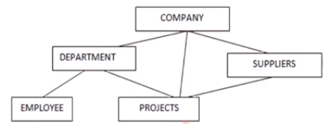
23IT201- DATABASE MANAGEMENT SYSTEMS
Network Data Model
Enhanced version of hierarchical data model
Helps to address M:N relationship
Also represented as hierarchical data model, but this model will not have single parent concept
Any child in the tree can have multiple parents here
Module 1 – DataBase System Architecture
Module 1
39

Slide 43
23IT201- DATABASE MANAGEMENT SYSTEMS
Network Data Model
Advantages
Accessing the records in the tables is easy since it addresses many to many relationships
One can easily navigate among the tables and get any data
Designed based on database standards – ANSI/SPARC
Disadvantages
No independence between any objects. Hence any changes to any of the object will need changes to the whole model
Little difficult to design the relationship between the entities, since all the entities are related in someway
Module 1 – DataBase System Architecture
Module 1
40

Slide 44
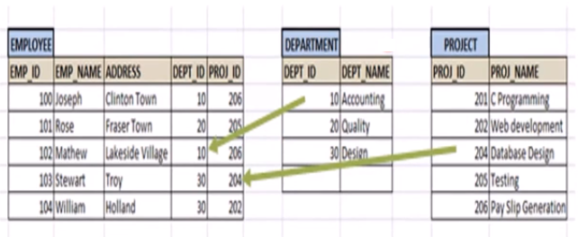
23IT201- DATABASE MANAGEMENT SYSTEMS
Relational Data Model
Define how they are structured in the database physically and how they are inter-related
Based on how the records in each table are related
Isolates physical structure from the logical structure
A relational data model revolves around 5 important rules
Order of rows/records in the table is not important
Each record in the table is unique
Each column/attribute will have single value in a row
All attributes should be from same domain
Table names in the database should be unique
Module 1 – DataBase System Architecture
Module 1
41

Slide 45
23IT201- DATABASE MANAGEMENT SYSTEMS
Relational Data Model
Advantages
Structural Independence - Any changes to the database structure, does not affect the way of accessing the data
Simplicity - Designed based on logical data and does not consider how data are stored physically in the memory
Easy to maintain and access
Supports Structured Query Language (SQL)
Disadvantages
High hardware cost
Lead to complexity in the database
Module 1 – DataBase System Architecture
Module 1
42

Slide 46
23IT201- DATABASE MANAGEMENT SYSTEMS
ER Model to Relational Model Mapping
Steps in ER Model to Relational Model Mapping
7-Step Process
Map Regular Entity Types
Map Weak Entity Types
Map Binary 1:1 Relation Types
Map Binary 1:N Relationship Types
Map Binary M:N Relationship Types
Map Multivalued Attributes
Map N-ary Relationship Types
ER Model to Relational Model Mapping:
Module 2 – Relational Query Languages
Module 1
43

Slide 47
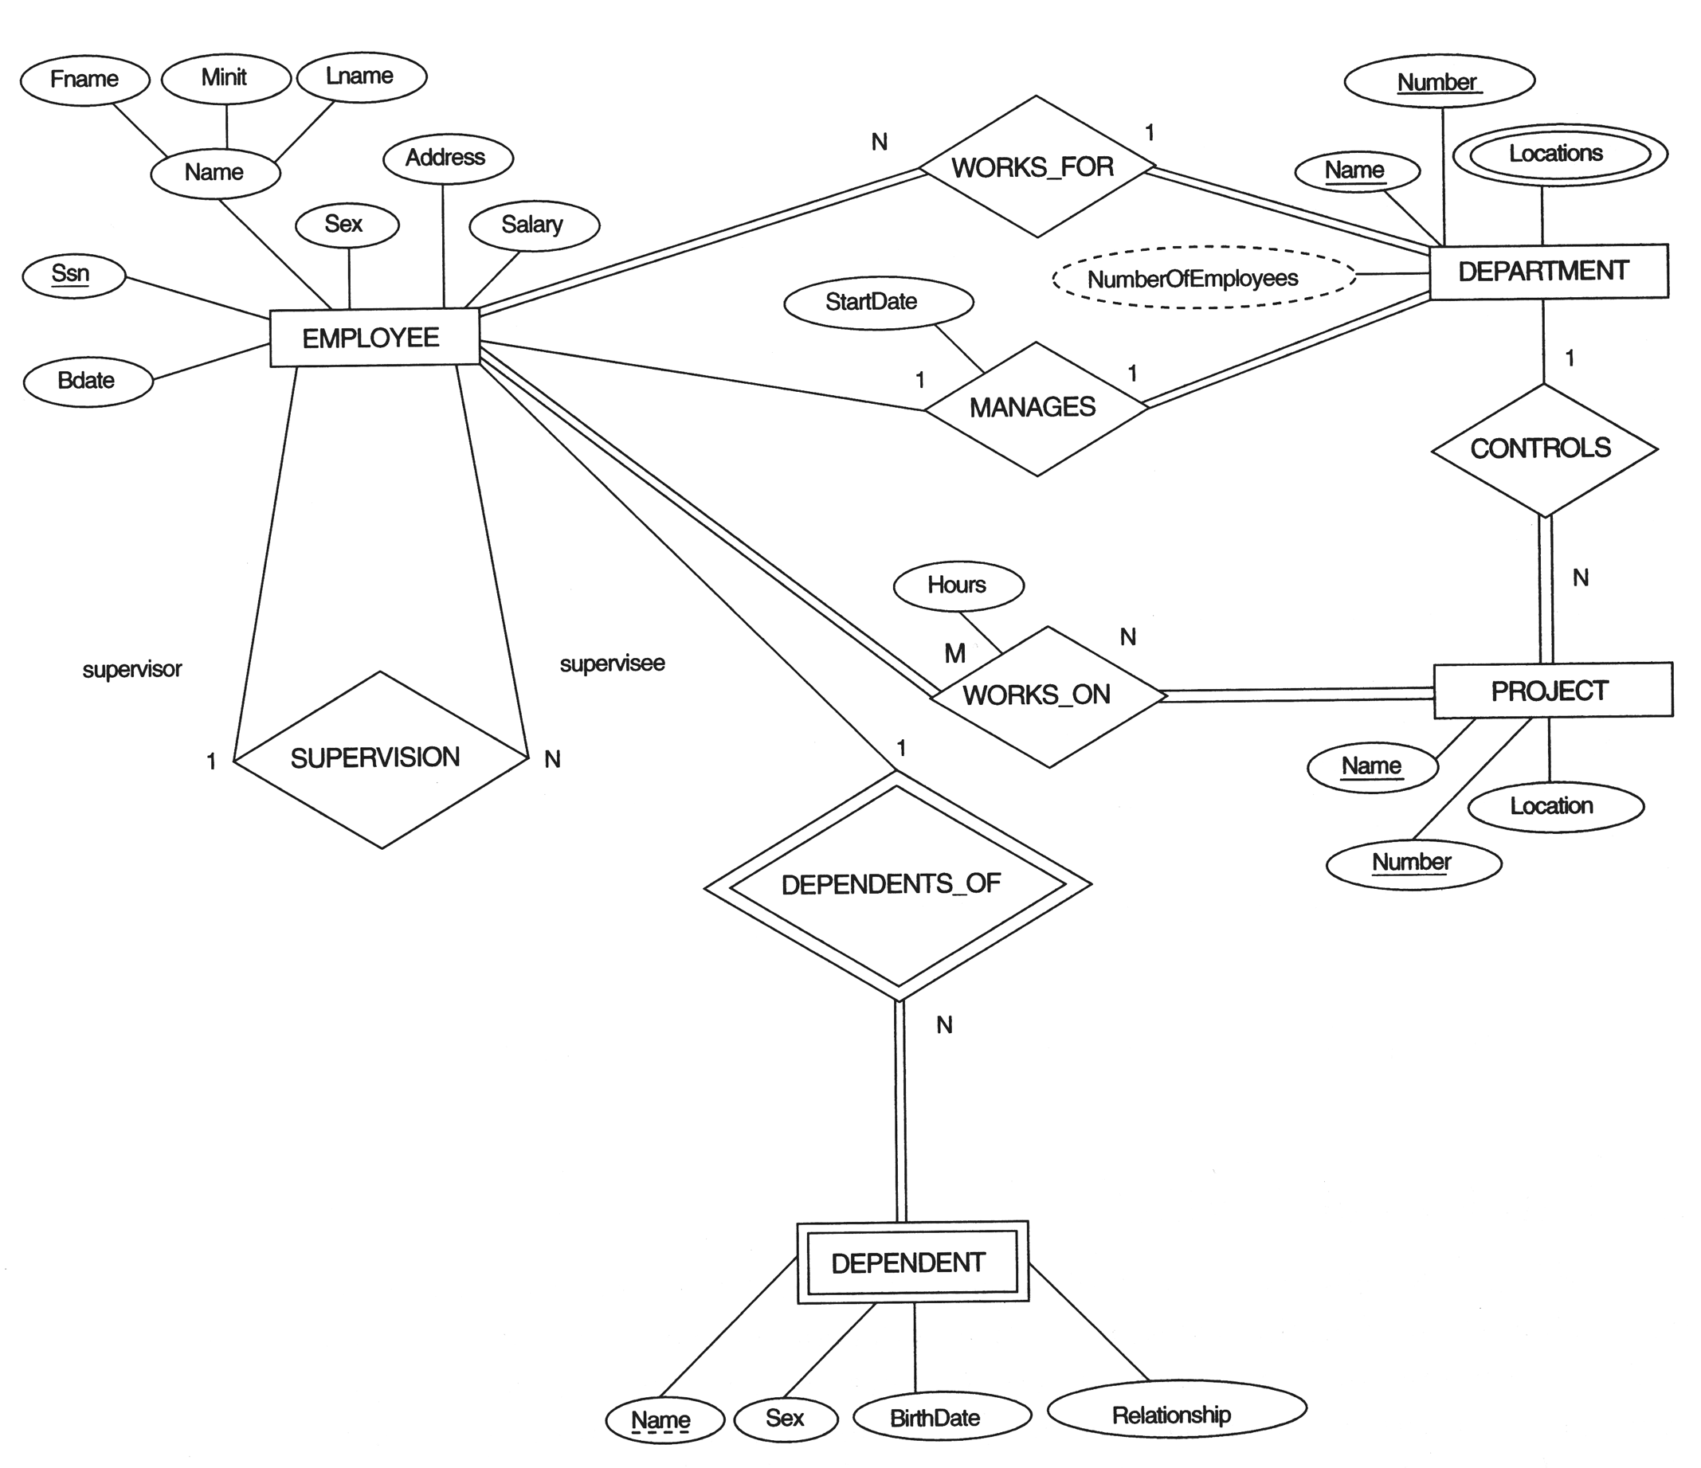
23IT201- DATABASE MANAGEMENT SYSTEMS
ER Model to Relational Model Mapping
ER Model
Module 2 – Relational Query Languages
Module 1
44

Slide 48
23IT201- DATABASE MANAGEMENT SYSTEMS
ER Model to Relational Model Mapping
Step 1 - Mapping of Regular Entity Types
For each regular (strong) entity type E in the ER schema, create a relation R that includes all the simple attributes of E
Choose one of the key attributes of E as the primary key for R
If the chosen key of E is composite, the set of simple attributes that form it will together form the primary key of R
Relations EMPLOYEE, DEPARTMENT, and PROJECT in the relational schema corresponding to the regular entities in the ER diagram
Module 2 – Relational Query Languages
Module 1
45

Slide 49
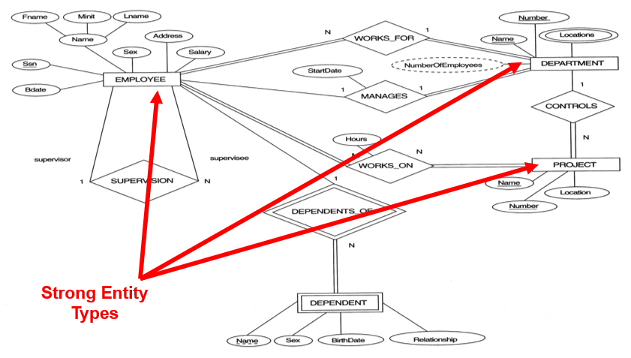
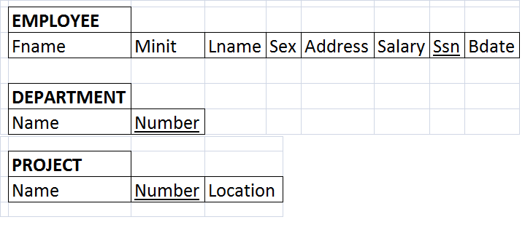
23IT201- DATABASE MANAGEMENT SYSTEMS
ER Model to Relational Model Mapping
Step 1 - Mapping of Regular Entity Types
ER Model
Relational Model
Module 2 – Relational Query Languages
Module 1
46

Slide 50
23IT201- DATABASE MANAGEMENT SYSTEMS
ER Model to Relational Model Mapping
Step 2 - Mapping of Weak Entity Types
For each weak entity type W in the ER schema with owner entity type E, create a relation R & include all simple attributes (or simple components of composite attributes) of W as attributes of R
Also, include as foreign key attributes of R the primary key attribute(s) of the relation(s) that correspond to the owner entity type(s)
The primary key of R is the combination of the primary key(s) of the owner(s) and the partial key of the weak entity type W, if any
Module 2 – Relational Query Languages
Module 1
47

Slide 51
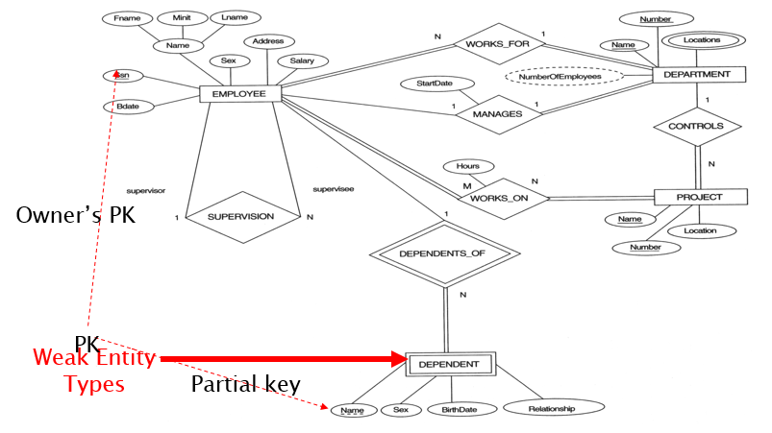
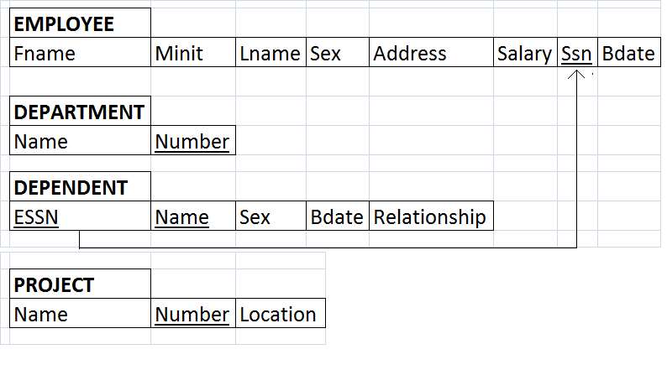
23IT201- DATABASE MANAGEMENT SYSTEMS
ER Model to Relational Model Mapping
Step 2 - Mapping of Weak Entity Types
ER Model
Relational Model
Module 2 – Relational Query Languages
Module 1
48

Slide 52
23IT201- DATABASE MANAGEMENT SYSTEMS
ER Model to Relational Model Mapping
Step 3 - Mapping of Binary 1:1 Relation Types
For 1:1 relationship key propagation may be used
Relationship can be represented either putting the primary key of the first entity in the second entity or vice versa
In some situations when mapping 1:1 relationship between entities, both entities and the relationship may be merged into one and represented by one relation
Module 2 – Relational Query Languages
Module 1
49

Slide 53
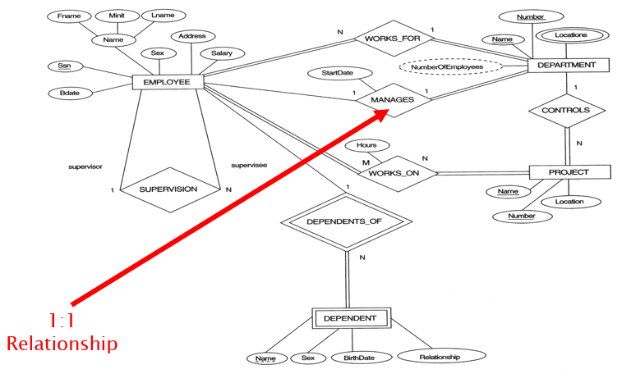
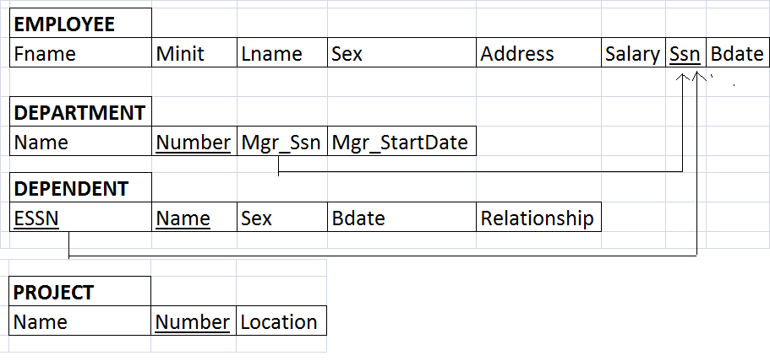
23IT201- DATABASE MANAGEMENT SYSTEMS
ER Model to Relational Model Mapping
Step 3 - Mapping of Binary 1:1 Relation Types
ER Model
Relational Model
Module 2 – Relational Query Languages
Module 1
50

Slide 54
23IT201- DATABASE MANAGEMENT SYSTEMS
ER Model to Relational Model Mapping
Step 4 - Mapping of Binary 1:N Relation Types
One instance of the first entity may be related to a number of instances of the second entity
But each instance of the second entity is related to only one instance of the first entity
Key propagation is possible in 1:N relationship
Propagation of primary key of first entity will happens.(E.g., From Department to Project)
Module 2 – Relational Query Languages
Module 1
51

Slide 55
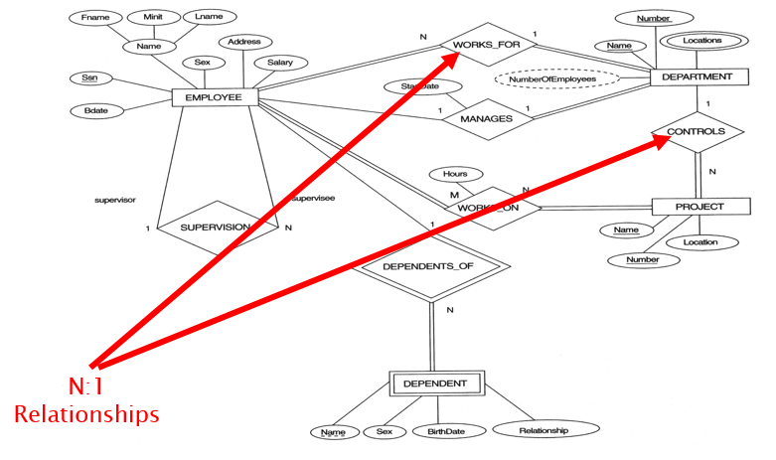
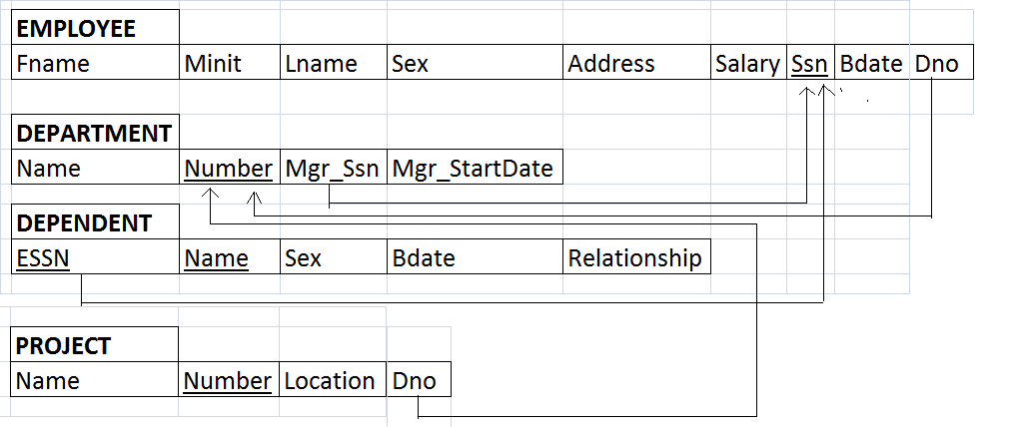
23IT201- DATABASE MANAGEMENT SYSTEMS
ER Model to Relational Model Mapping
Step 4 - Mapping of Binary 1:N Relation Types
ER Model
Relational Model
Module 2 – Relational Query Languages
Module 1
52

Slide 56
23IT201- DATABASE MANAGEMENT SYSTEMS
ER Model to Relational Model Mapping
Step 5 - Mapping of Binary M:N Relation Types
Key Propagation is not possible in many-to-many relationship
Many-to-Many relationships must be represented by a separate table
The primary keys of each of the entities that participates in the relationship are included in this relation
The combination of the primary keys of entity will form the primary key of relation
Any attributes of the relationship can be included in this relation
Module 2 – Relational Query Languages
Module 1
53

Slide 57
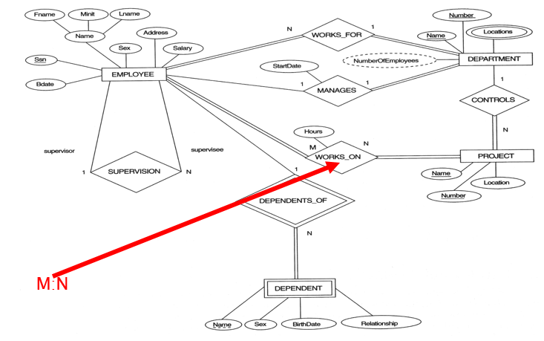
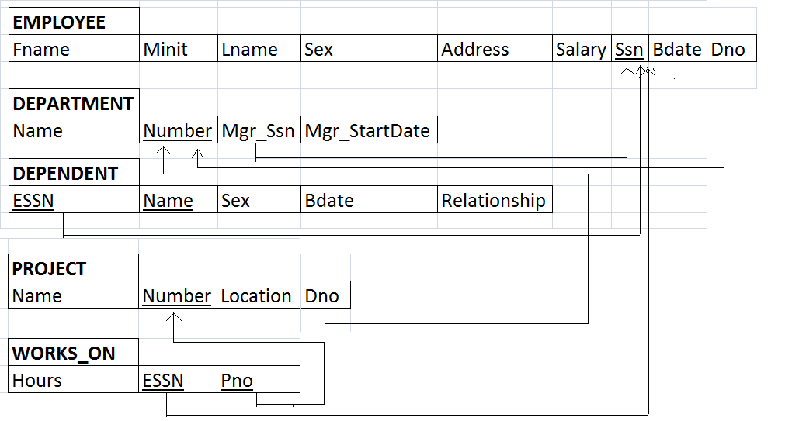
23IT201- DATABASE MANAGEMENT SYSTEMS
ER Model to Relational Model Mapping
Step 5 - Mapping of Binary M:N Relation Types
ER Model
Relational Model
Module 2 – Relational Query Languages
Module 1
54

Slide 58
23IT201- DATABASE MANAGEMENT SYSTEMS
ER Model to Relational Model Mapping
Step 6 - Mapping of Multivalued Attributes
For each multivalued attribute A, create a new relation R
This relation R will include an attribute corresponding to A, plus the primary key attribute K-as a foreign key in R-of the relation that represents the entity type of relationship type that has A as an attribute
The primary key of R is the combination of A and K
If the multivalued attribute is composite, include its simple components
Module 2 – Relational Query Languages
Module 1
55

Slide 59
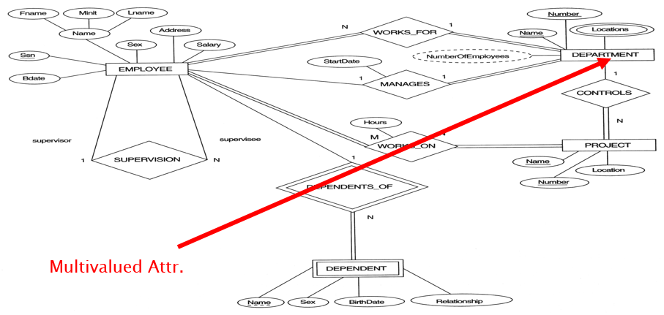

23IT201- DATABASE MANAGEMENT SYSTEMS
ER Model to Relational Model Mapping
Step 6 - Mapping of Multivalued Attributes
ER Model
Relational Model
Module 2 – Relational Query Languages
Module 1
56

Slide 60


23IT201- DATABASE MANAGEMENT SYSTEMS
ER Model to Relational Model Mapping
Step 7 - Mapping of N-ary Relationship Types
For each n-ary relationship type R, where n>2, create a new relationship S to represent R
Include as foreign key attributes in S the primary keys of the relations that represent the participating entity types
Also include any simple attributes of the n-ary relationship type (or simple components of composite attributes) as attributes of S
ER Model
Relational Model
Module 2 – Relational Query Languages
Module 1
57

Slide 61

23IT201- DATABASE MANAGEMENT SYSTEMS
ER Model to Relational Model Mapping
Relational Model
Module 2 – Relational Query Languages
Module 1
58

Slide 62
23IT201- DATABASE MANAGEMENT SYSTEMS
Introductions to Data Models-Hierarchical Model, Network Model, Object Oriented Model, Entity–Relationship Model, Relational Model
Summary
Hierarchical Data Model
Network Data Model
Relational Data Model
ER Model to Relational Model Mapping
Data Models
Types of Data Models
Physical Data Models
Object Based Data Models
Entity Relationship (ER) Data Model
Object Oriented (OO) Data Model
Record Based Data Models
Module 1

Slide 63
23IT201- DATABASE MANAGEMENT SYSTEMS
Introductions to Data Models-Hierarchical Model, Network Model, Object Oriented Model, Entity–Relationship Model, Relational Model
Try Yourself
Draw an ER diagram for a University DataBase
Draw a OO Data Model with the classes Person and Student
Draw a Hierarchical Data Model for a Customer DataBase
Draw a Network Data Model for a School DataBase
Draw a Relational Data Model for a College DataBase
Module 1

Slide 64
23IT201- DATABASE MANAGEMENT SYSTEMS
Introductions to Data Models-Hierarchical Model, Network Model, Object Oriented Model, Entity–Relationship Model, Relational Model
Try Yourself
Convert the following ER Model to Relational Schema:
Module 1

Slide 65
23IT201- DATABASE MANAGEMENT SYSTEMS
Data Models – Introduction, Benefits, and Phases, ER Diagrams – Symbols, Components, Relationships, Weak entities, Attributes, Cardinality
Try Yourself
Convert the following ER Model to Relational Schema:
Module 1

Slide 66
23IT201- DATABASE MANAGEMENT SYSTEMS
Session 4 - Relational Algebra, Domain Relational Calculus, Tuple Relational Calculus
Module 1

